Slide 1
Group 9
張峻豪 (0586038)
黃俊雄 (0656543)
李昱賢 (0656129)
簡旭彤 (0686007)
Sanoop M (0686018)
Susanta Sharma (0686020)
Kohilambal Ramesh (0480821)

Slide 2
Introduction
Environment：Linux ／Unix
Language ：C
Idea ：Use low level function to implement different commands.

Slide 3
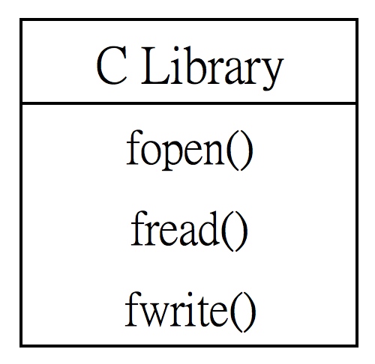
Command – cp (copy file)
Example
Use 3 C function.

Slide 4
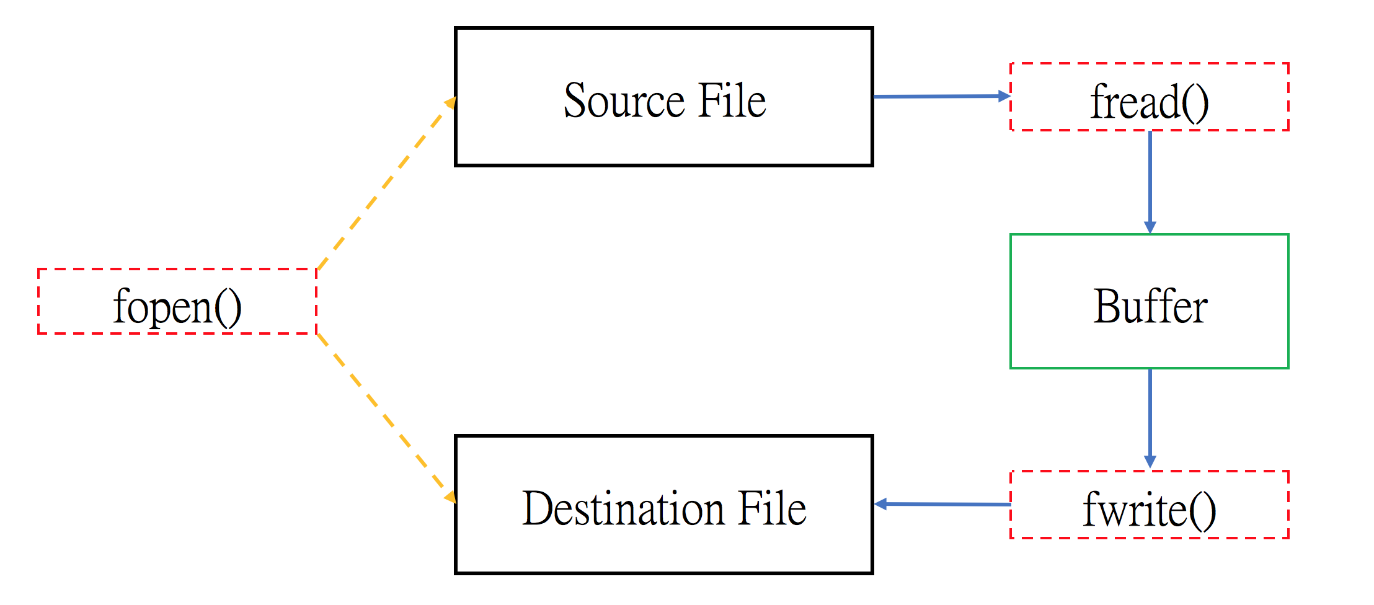
Command – cp (copy file)
Use fread() to read source file to buffer.
Use fopen() to open
source file and destination file.
Use fwrite() to write buffer to destination file.

Slide 5
Division of Work
Main Program ：黃俊雄
List File ： Kohilambal Ramesh
Copy ：李昱賢
Delete ： Susanta
Rename ： Sanoop
Create File ：簡旭彤
Report/Presentation ：張峻豪

